Slide 1


PROTEIN–PROTEIN INTERACTIONS

Slide 2



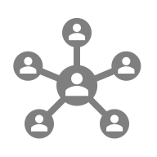

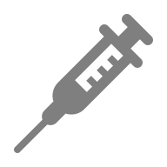

PROTEIN–PROTEIN INTERACTIONS?
🔗 Connections between proteins underpin almost all cellular processes
🧩 From structural complexes to transient regulatory encounters
📡 Basis for network-level biological organization

Slide 3
WHY PPIS MATTER IN BIOLOGY
🧬 Regulate information flow inside cells
⚙️ Control enzymatic activity, localization, degradation
🧱 Form the architecture of molecular machines

Slide 4
FROM SINGLE PROTEINS TO NETWORKS
🌐 PPIs connect proteins into pathways and modules
🔀 Emergent properties appear only at the network level

Slide 5
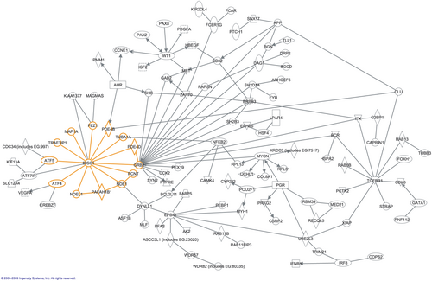
INTERACTOME: THE BIG PICTURE
🌍 The complete set of PPIs in an organism

Slide 6
TYPES OF PROTEIN INTERACTIONS
🧲 Stable complexes (e.g., ribosome, proteasome)
⚡ Transient signaling interactions
🎯 Conditional/context-specific PPIs

Slide 7
PHYSICAL VS FUNCTIONAL INTERACTIONS
🧱 Physical = direct binding
📈 Functional = correlated activity without binding

Slide 8
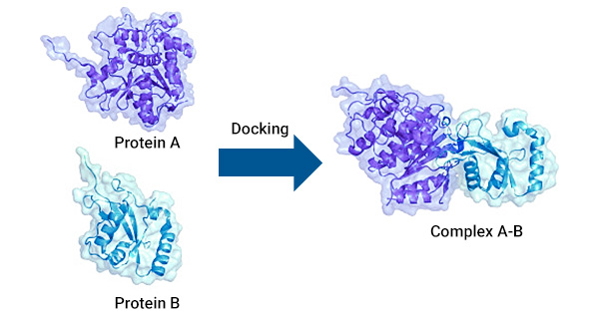
DOMAINS & MOTIFS IN PPIS
🧩 Binding determined by structural domains
📏 Short linear motifs mediate many regulatory contacts

Slide 9
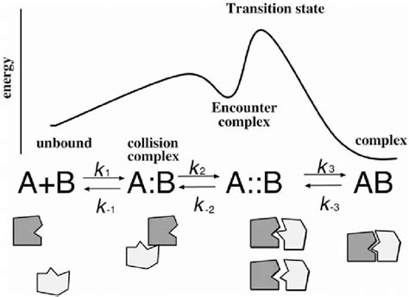
ENERGETICS OF PROTEIN BINDING
💧 Desolvation and entropy play critical roles
🔥 Affinity depends on ΔG and interface geometry

Slide 10
SPECIFICITY VS PROMISCUITY
🎯 High-specificity interactions (e.g., antibodies)
🔀 Promiscuous hubs interact with many partners

Slide 11
PPIS AS INFORMATION FLOW
📡 Signaling cascades propagate through interactions
🔁 Feedback loops create control circuits

Slide 12


EXPERIMENTAL DETECTION OVERVIEW
🧪 Many complementary techniques
📏 Each captures different interaction types

Slide 13
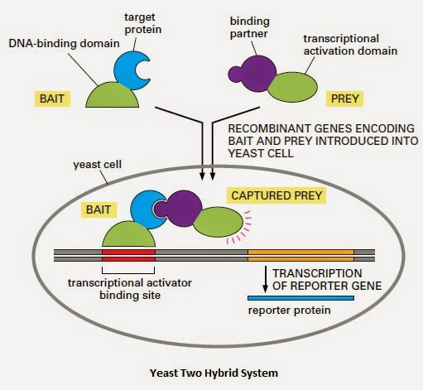
YEAST TWO-HYBRID
🧫 Detects binary physical interactions
⚠️ High false positives

Slide 14
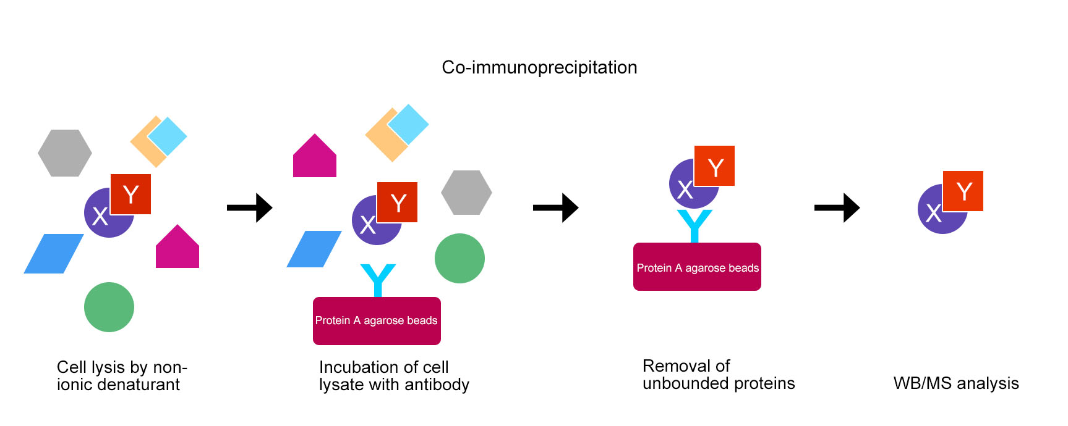
CO-IMMUNOPRECIPITATION
🧬 Detects stable complexes from cell lysate
🪤 Missing transient interactions

Slide 15
AFFINITY PURIFICATION-MS
🧲 Captures protein complexes in vivo
🧫 Followed by mass spectrometry identification

Slide 16
PROTEIN MICROARRAYS
🧃 High-throughput probe–target screening
⚠️ Requires purified proteins

Slide 17
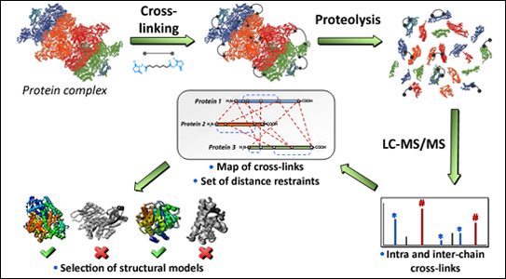
CROSSLINKING-MS
🧬 Provides structural restraints
🔗 Captures proximal residues via chemical crosslinkers

Slide 18
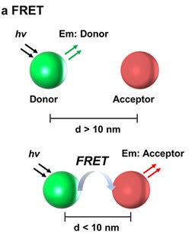
FRET/BRET
💡 Detects nanoscale proximity in living cells
🎥 Real-time interaction monitoring

Slide 19
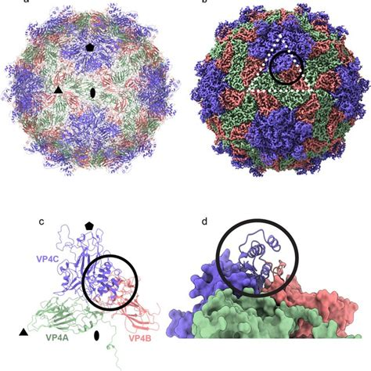
CRYO-EM FOR COMPLEXES
❄️ Provides structures of large assemblies
🔬 Reveals architecture of megacomplexes

Slide 20
LIMITATIONS OF EXPERIMENTAL METHODS
⚠️ Context dependency
📉 High noise & false positives

Slide 21
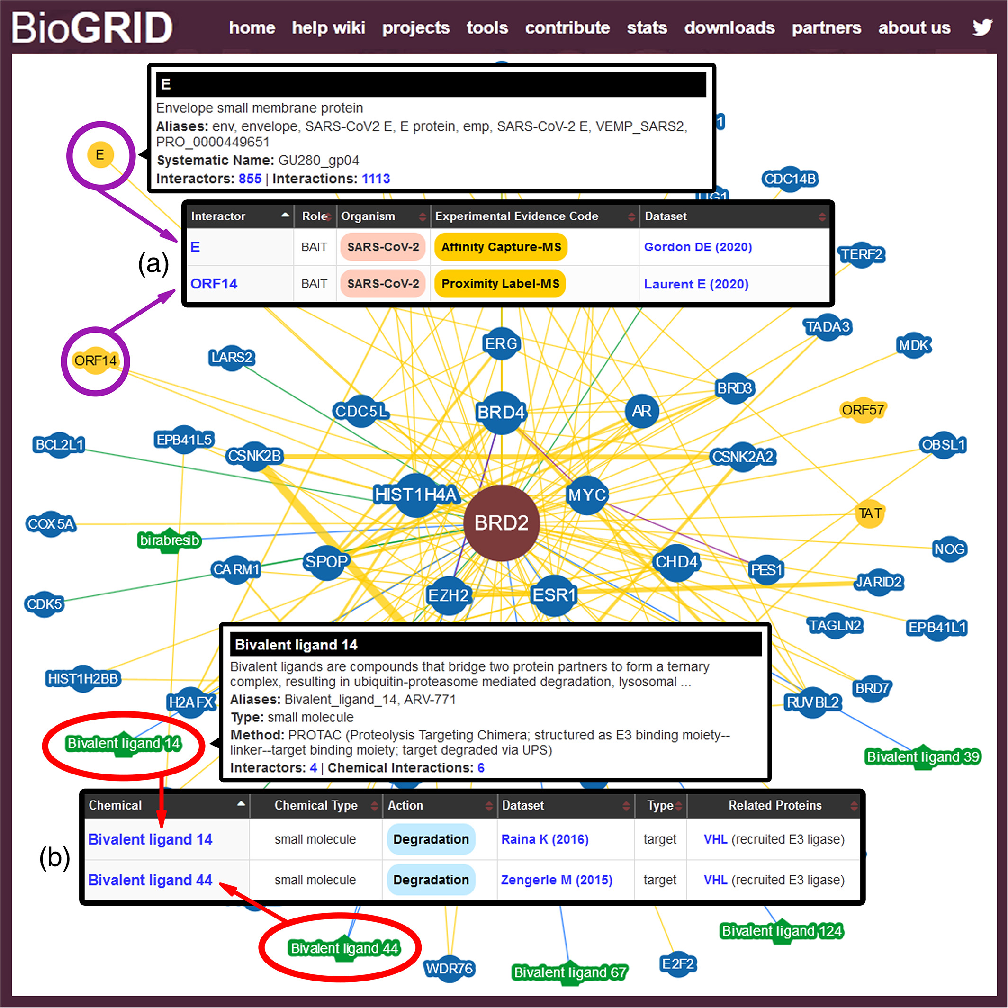

BIOGRID
🗄️ Curated genetic & physical interactions
🔬 Covers multiple species

Slide 22
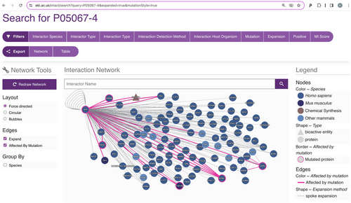
INTACT
📚 Expert-curated molecular interactions
🧬 Standardized PSI-MI annotation

Slide 23
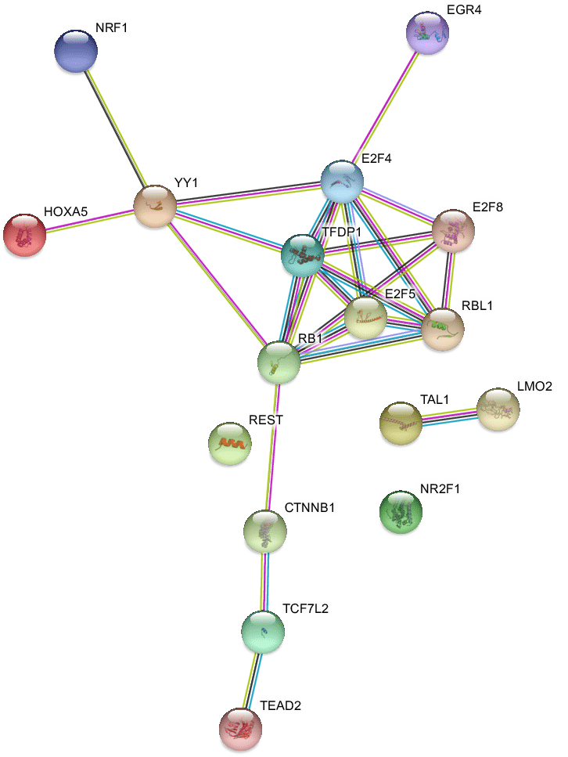
STRING
🌐 Functional interactions from many sources
🎯 Confidence scoring of edges

Slide 24
HUMAN INTERACTOME PROJECTS
👤 Systematic mapping efforts
🗺️ Moving toward a complete human interactome

Slide 25
INTERACTOME COVERAGE PROBLEMS
🕳️ Sparse and biased sampling
📉 Many transient interactions missing

Slide 26
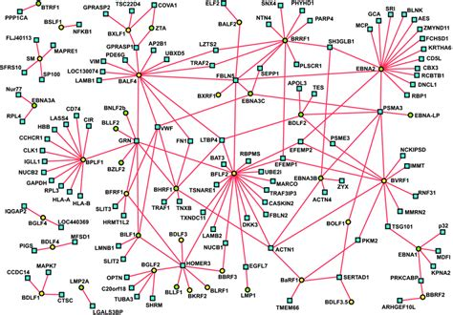
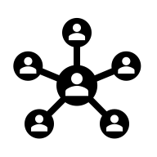
NETWORKS AS GRAPHS
🕸️ Proteins = nodes, interactions = edges
📊 Graphs capture system-level topology

Slide 27
DEGREE, HUBS & CENTRALITY
🌐 Hubs organize network structure
⭐ Centrality predicts functional importance

Slide 28
DEGREE, HUBS & CENTRALITY
Degree centrality 🧮 — counts how many edges a node has
Closeness centrality 📏 — how close a node is to all others
Eigenvector centrality 🌟 — importance of neighbors influences importance

Slide 29
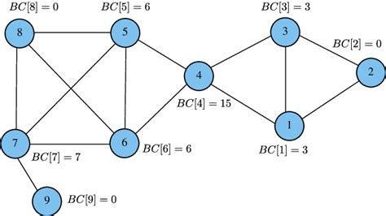
BETWEENNESS
🌐 How often node is on the shortest path?

Slide 30
MODULARITY & COMMUNITIES
🏘️ Modules correspond to pathways
🧬 Clustering reveals biological functions
📏 Algorithms like Louvain, Infomap,
or Girvan - Newman

Slide 31
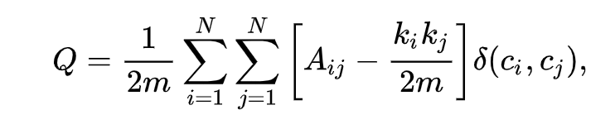
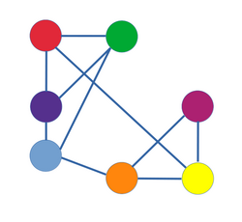
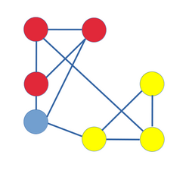
LOUVAIN ALGORITM

Slide 32
NETWORK MOTIFS
🔁 Recurrent patterns (e.g., feed-forward loops)
🧠 Motifs implement biological logic

Slide 33
GRAPH ALGORITHMS
🧮 Shortest paths = signaling routes
🎣 Network alignment & similarity

Slide 34
DIFFUSION ON NETWORKS
💧 Models spreading of signals
📈 Useful for disease gene prioritization

Slide 35
GRAPH KERNELS
🧩 Compute similarities between nodes
🔍 Effective for function prediction

Slide 36
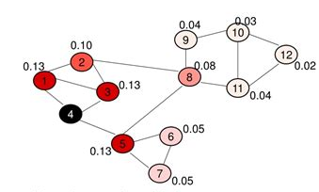
RANDOM WALK WITH RESTART
🚶 Identifies network-proximal genes

Slide 37
KNOWLEDGE GRAPH REPRESENTATIONS
🧠 Merging proteins, drugs, pathways
🔗 Enables reasoning over heterogenous data

Slide 38

DEEP LEARNING IN PPI PREDICTION
🧠 Models infer binding from sequences/structures
📈 Outperforms classical approaches

Slide 39
GRAPH NEURAL NETWORKS (GNNS)
🔗 Operate directly on interaction graphs
🧩 Integrate topology with features

Slide 40
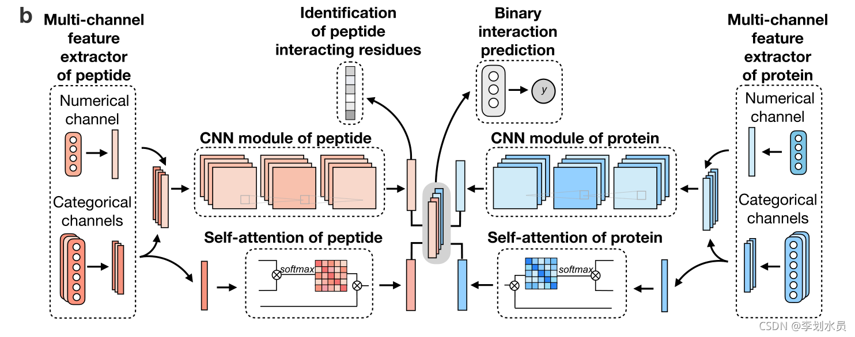
SEQUENCE-BASED MODELS
🧬 Transformers extract binding features

Slide 41
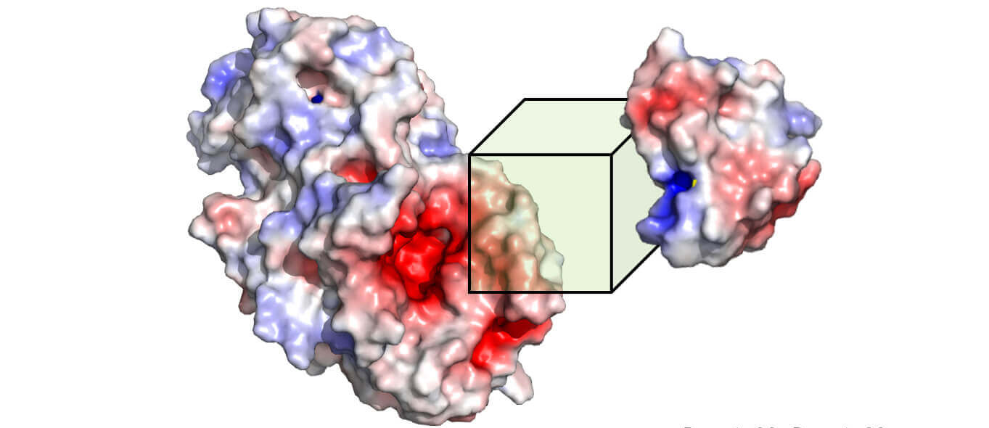
STRUCTURE-BASED MODELS
⛓️ 3D CNNs or equivariant networks
🗿 Predict interfaces & affinities

Slide 42
ALPHAFOLD-MULTIMER
🤖 Predicts multimeric structures
🧩 Provides interface residues directly

Slide 43
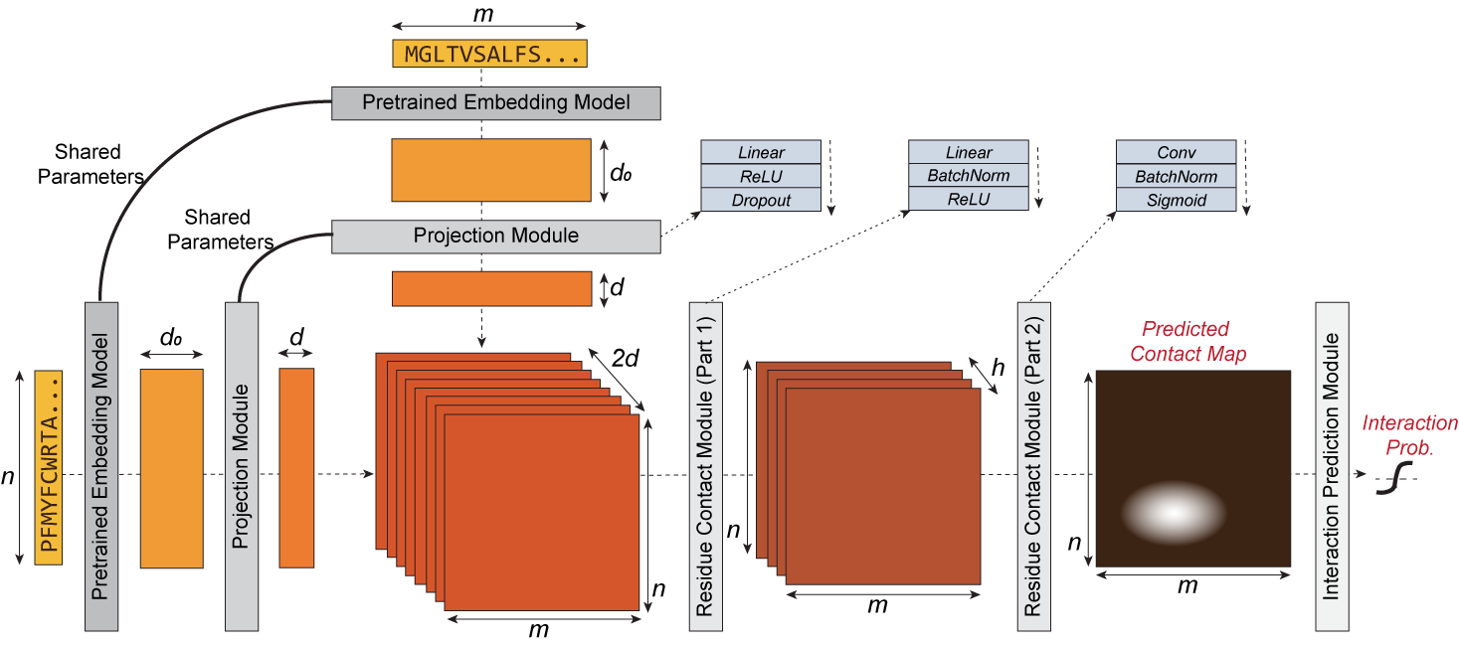
D-SCRIPT
📜 Infers interactions from embeddings

Slide 44
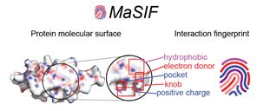
MASIF
🌀 Geometric deep learning on molecular surfaces
🎯 Predicts binding sites and partners

Slide 45
DIFFDOCK & DIFFUSION MODELS
🌫️ Generative docking approaches
🤝 Also applied to PPI interface design

Slide 46
REPRESENTATION LEARNING CHALLENGES
🧩 Integrating sequences + structures + networks
🧱 Limited ground-truth data

Slide 47
BENCHMARKING & EVALUATION
📊 Train/test leakage issues
📉 Overfitting to hubs common

Slide 48
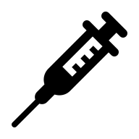
SIGNAL TRANSDUCTION OVERVIEW
📡 Information flows via PPIs
🔗 Ligand → receptor → cascade

Slide 49
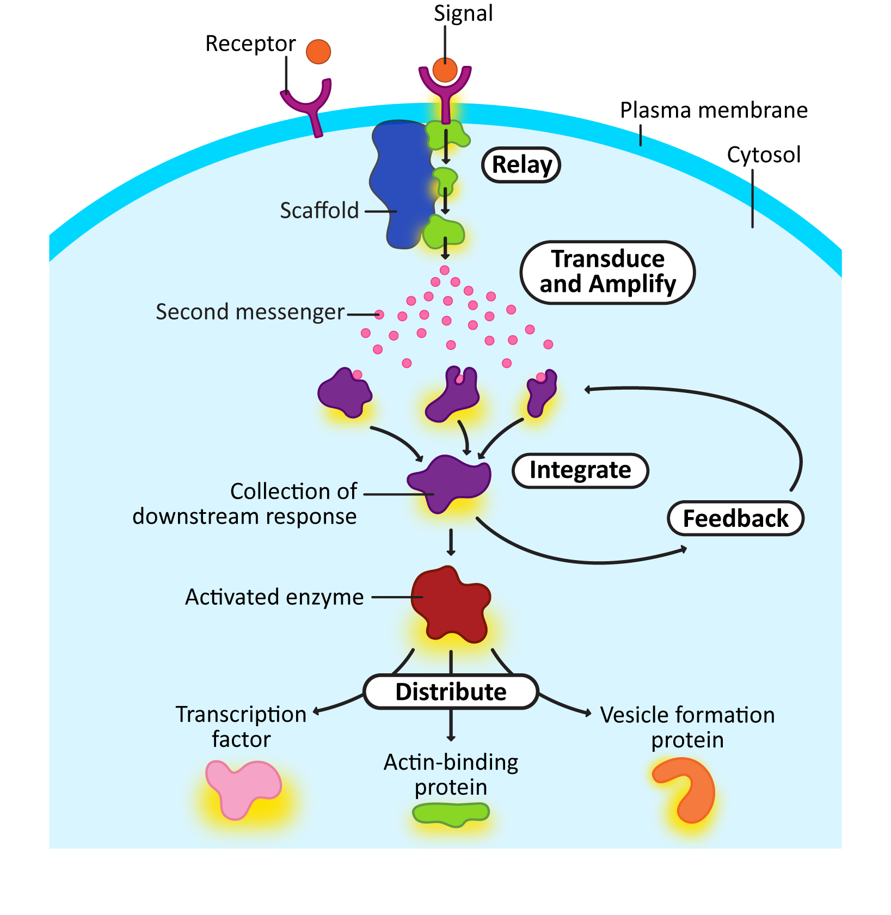
RECEPTOR–LIGAND INTERACTIONS
🛎️ Start signaling cascades
🧲 Trigger phosphorylation networks

Slide 50
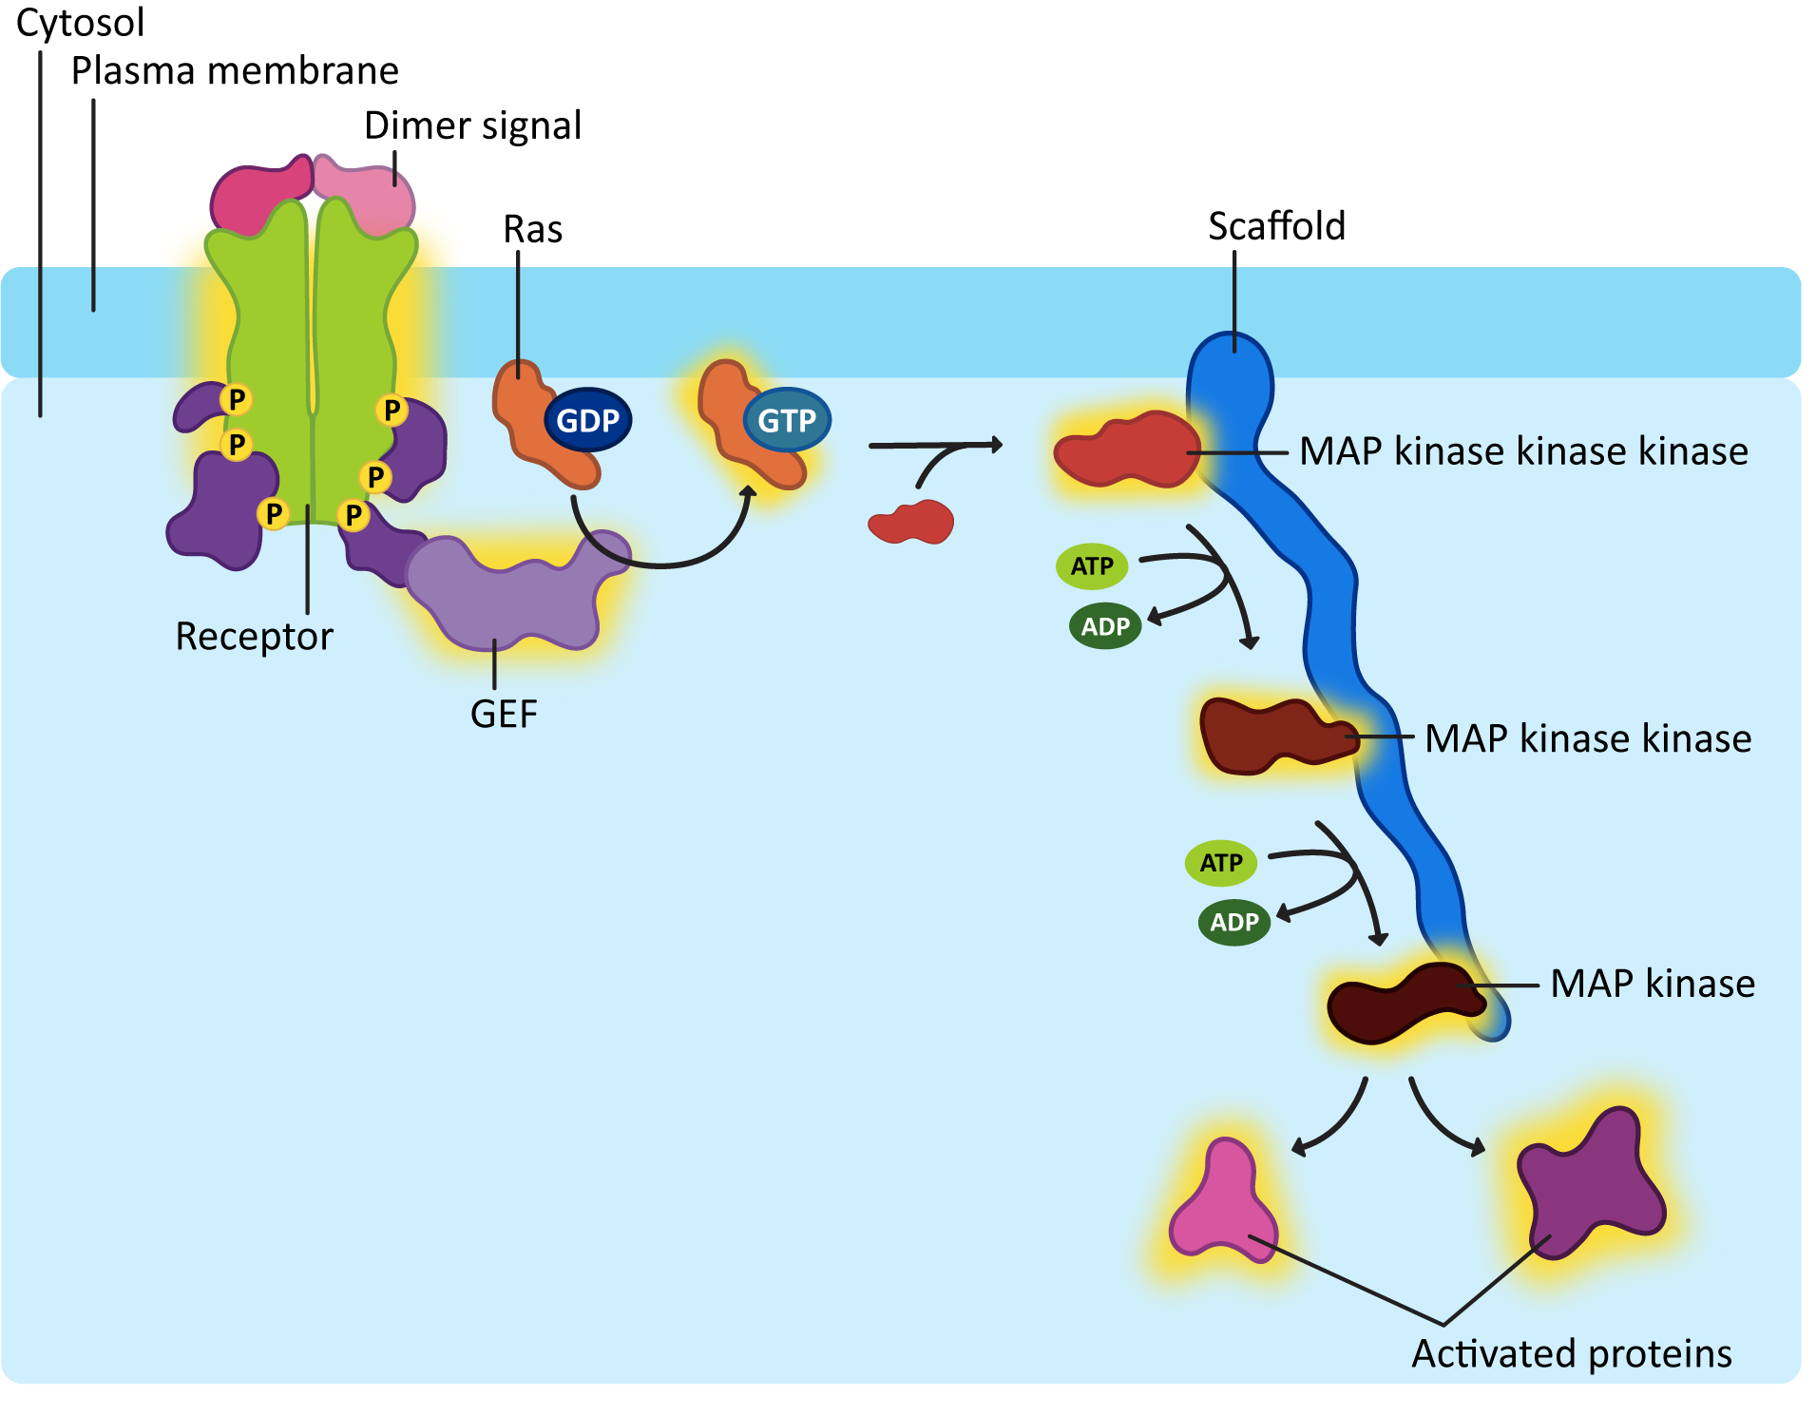
KINASE–SUBSTRATE NETWORKS
⚡ Kinases regulate thousands of targets
🔀 Create branching decision circuits

Slide 51
SCAFFOLD & ADAPTOR PROTEINS
🧱 Organize multi-step pathways
🏗️ Increase signaling specificity

Slide 52
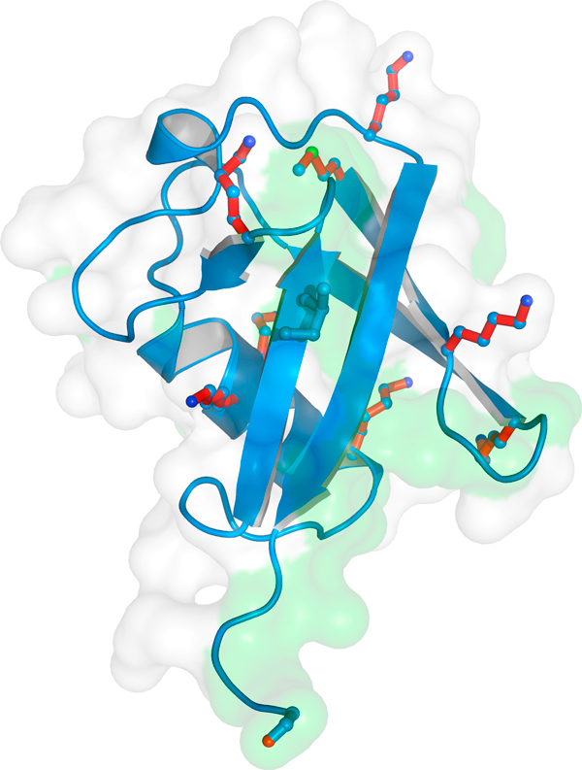
UBIQUITIN SIGNALING
♻️ Regulates degradation & trafficking
🔗 Ubiquitin ligases form dense networks

Slide 53
TRANSCRIPTION FACTOR ACTIVATION
🧬 PPIs ultimately regulate gene expression
📨 TFs integrate upstream signals

Slide 54
APOPTOSIS INTERACTION NETWORKS
💀 Controlled by multi-protein complexes
⚖️ Balance of pro- and anti-apoptotic PPIs

Slide 55
CROSS-TALK BETWEEN PATHWAYS
🔄 Signals converge/diverge dynamically
🎛️ Enables context-specific responses

Slide 56
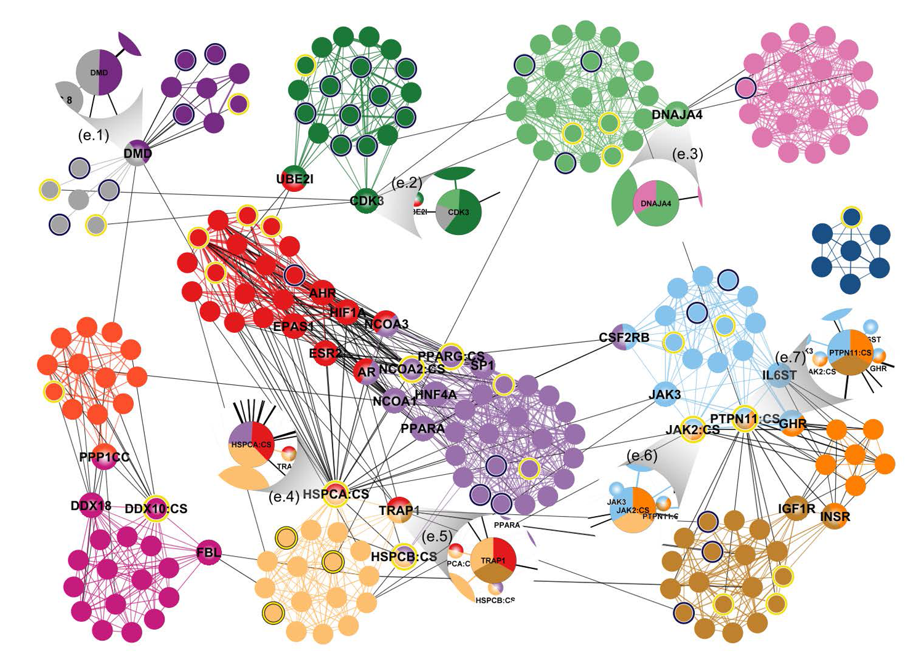
NETWORK ROBUSTNESS & FAILURE
🛡️ Redundancy protects against noise
💥 Mutations in hubs cause disease

Slide 57

WHY TARGET PPIS?
🎯 Many diseases arise from broken interactions
💊 PPIs are emerging drug targets

Slide 58
INTERFACE HOTSPOTS
🔥 Small sets of residues dominate binding
🔍 Hotspots are key for inhibitor design

Slide 59
PPI INHIBITOR STRATEGIES
💊 Small molecules disrupting interfaces
🧩 Peptide mimetics of binding motifs

Slide 60
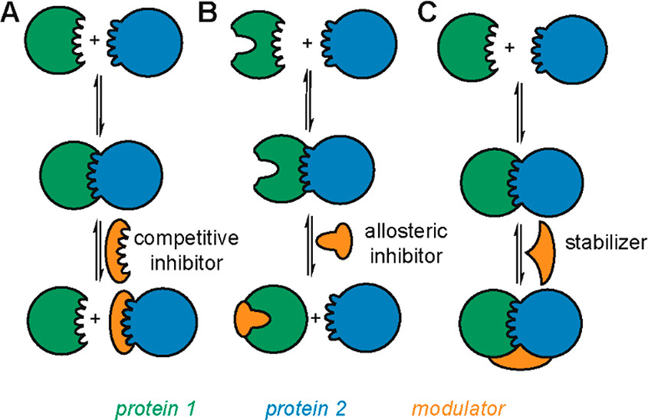
PPI INHIBITOR STRATEGIES

Slide 61
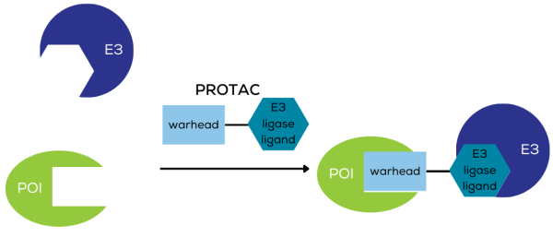
STABILIZING PPIS
🛠️ Molecular glues & PROTACs
📌 Useful for targeted degradation

Slide 62
COMPUTATIONAL PPI DESIGN
🧠 Design interfaces using physics + AI
🖥️ Rosetta & deep-learning pipelines

Slide 63
AFFINITY PREDICTION
⚖️ ΔG prediction from structure or sequence
📊 Used in mutational scanning

Slide 64
MUTATIONAL EFFECTS ON PPIS
🧬 Mutations reshape interfaces
🩺 Crucial for interpreting variants

Slide 65
DEEP MUTATIONAL SCANNING
🧫 High-throughput fitness maps
🧠 Inputs for ML affinity prediction

Slide 66
INTERACTOME-BASED DRUG DISCOVERY
🔍 Drug repositioning using network proximity
🌐 Targeting pathway clusters

Slide 67
DISEASE MODULES
🧩 Disease genes cluster in networks
📌 Useful for biomarker discovery

Slide 68
FUTURE DIRECTIONS
🧠 Generative PPI design
🌫️ Integrating single-cell interactomes

Slide 69
SUMMARY
📌 PPIs = foundation of cellular information flow
💡 Networks + AI reveal hidden organization

